Slide 1
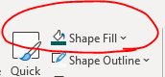













Business and Accelerator Icons
A full set of icons can be downloaded here.
All icons can be recolored by selecting and using the Shape Fill button
Power
Wind
Gas Power
GE Vernova Hitachi Nuclear Energy
Hydro Power
Steam Power
Wind Turbine Blades
Offshore Wind
Onshore Wind
Electrification
Accelerators
Electrification Software
Grid Solutions
Power Conversion & Storage
Financial Services
Consulting Services
Advanced Research

Slide 2














Generic Icons
Target
Handshake
Electricity
Calendar
Power Button
Clock
Checkmark
Cancel
People
Performance
Up Arrow
Down Arrow
Right Arrow
Left Arrow

Slide 3














Generic Icons
Alarm
Report
Shield
Play
Information
Question
Download
Upload
Lock
Unlock
Magnifying Glass
Trophy
Vision
Folder

Slide 4














Generic Icons
Settings
Government
Document
Forklift
Pin
0%
25%
50%
75%
100%
Calculator
Data
Star
Code

Slide 5














Generic Icons
Strategy
Organization Chart
Globe
Data Sharing
ERP
Internet
Data Aggregation
Dollar
Algorithm
Database
Airplane
Air Freight
Truck
Tractor Trailer

Slide 6














Generic Icons
Care for Earth
Trees
Travel Mug
Utensils
Light Switch
Recycled Bag
Volunteer
Podcast
Menu
Search
Right/Internal Link
Down/Scroll Down
Left/Back Link
Up/Top Link

Slide 7














Generic Icons
Link to new page/content
Up/Down
Expand/Collapse
Video Play
Close
Download
External Page Link
Contact Us/Mail
Quality
EHS
Trash Can
Camera
Rocks
House

Slide 8





Generic Icons
Overview
Settings
Tools
Page
System Overview

Slide 9



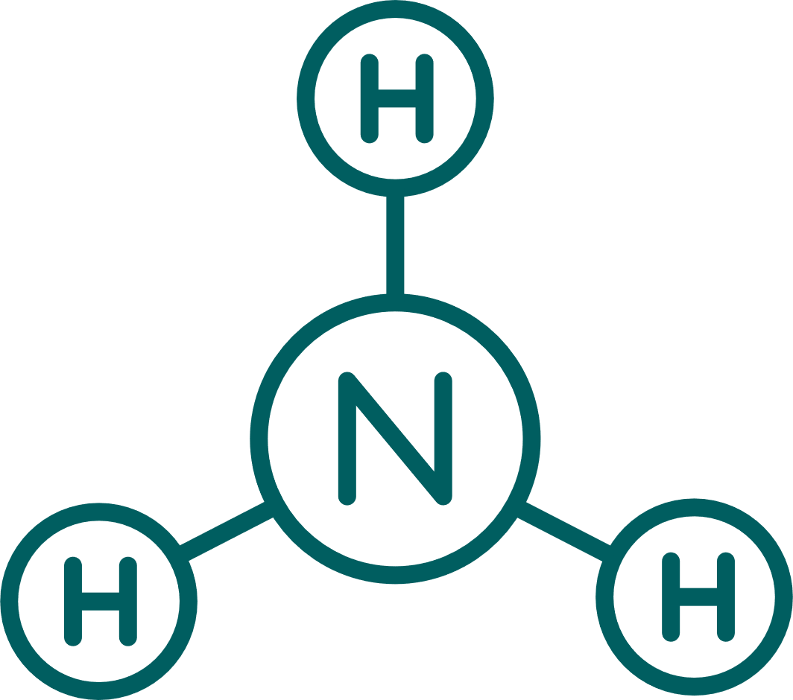










Gas Power Icons
Natural Gas
Hydrogen
CO₂ (a)
CO₂ (b)
Ammonia
Carbon Capture
Shipping
Office Building
Pipe Transportation
Terminal
Heat Transfer Fluids
Coal-fired Power Gen
Gas-fired Power Gen (a)
Gas-fired Power Gen (b)

Slide 10










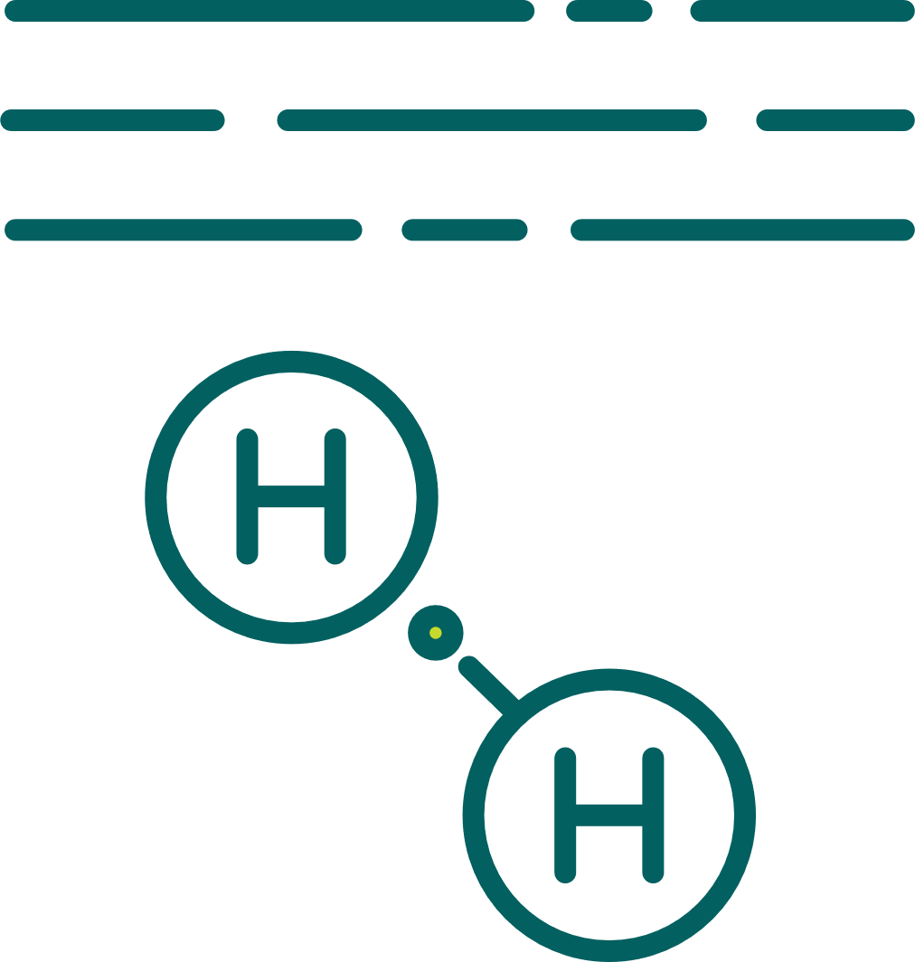
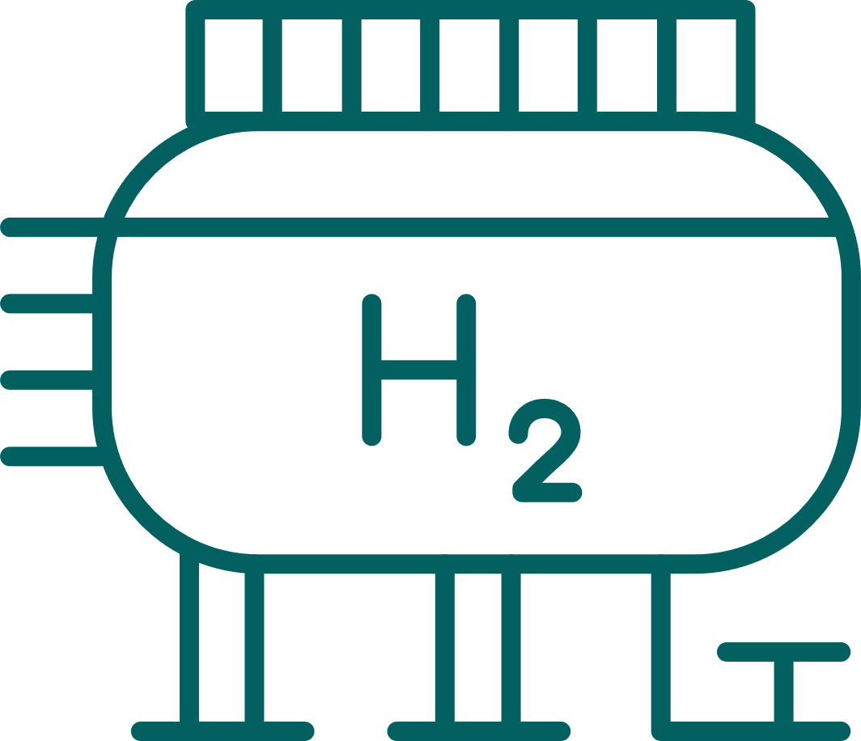
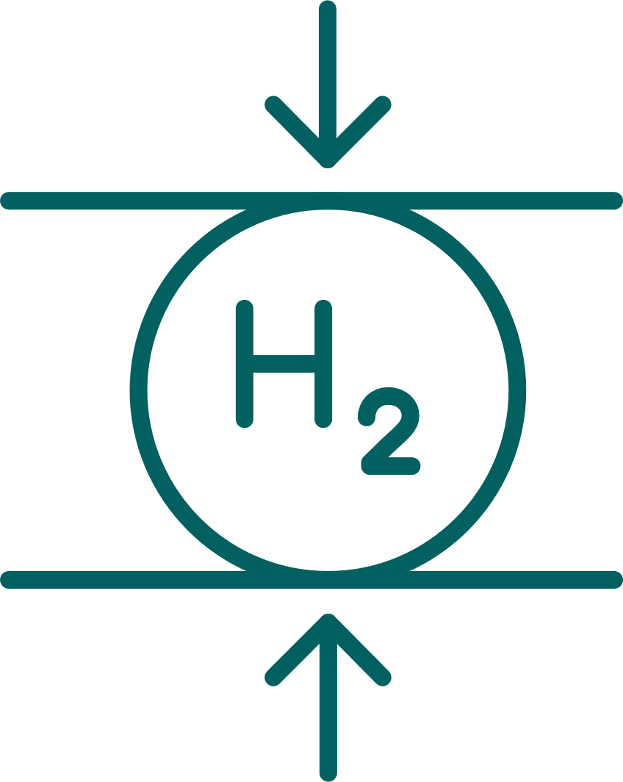
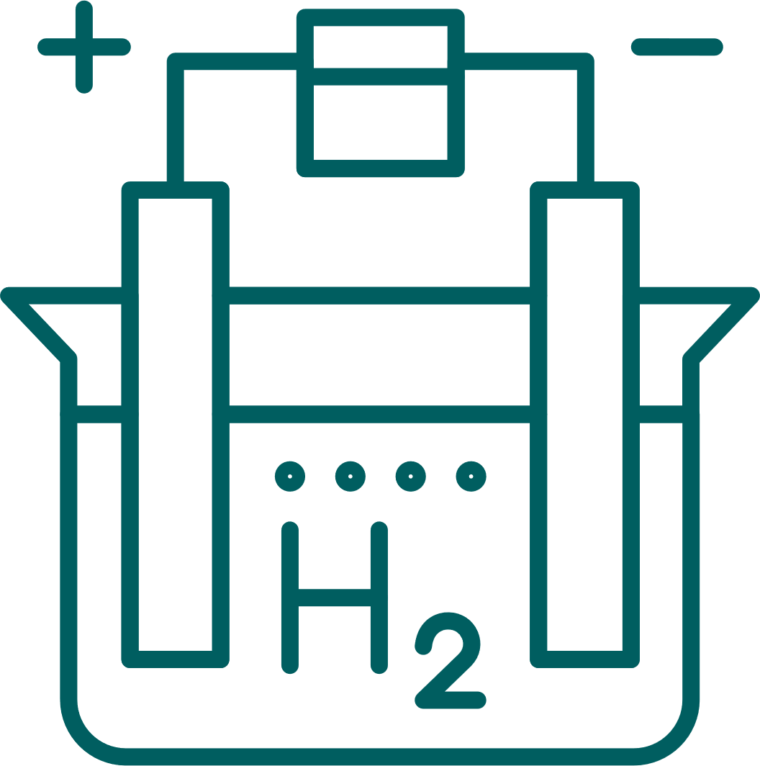
Gas Power Icons
Biomass Power Gen
Waste Incineration
LNG Liquefaction
Gas Engines
Chemical Plant
Refinery Plant
Steel Plant
Cement Plant
CO₂ Storage in Ground
CO₂ Storage in Ocean
H₂ Storage Underground
H₂ Storage Tank
H₂ Compressor
H₂ Electrolyzer

Slide 11
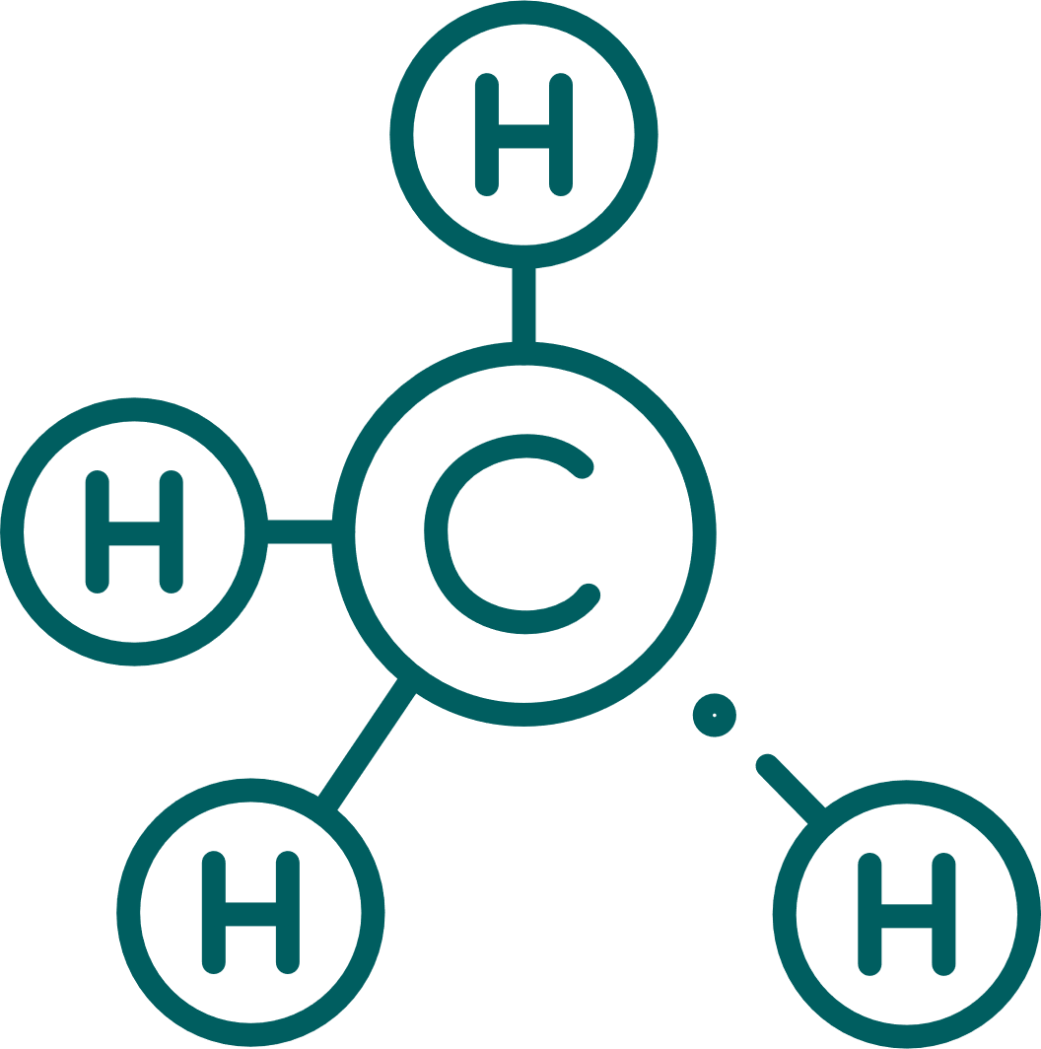







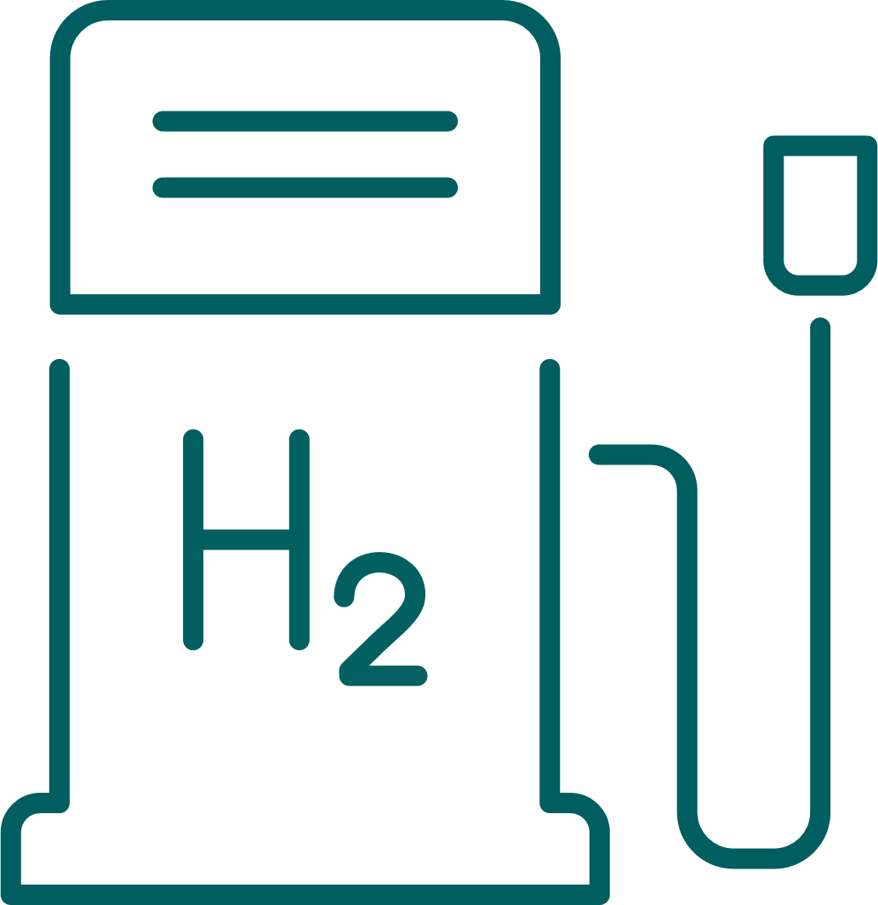





Gas Power Icons
Methane
Nuclear
Small Modular Reactor
Transformer
Gas Turbine (side view)
Solar Panel
Wind and Solar
Aero Turbine
Fuel: Coal
Fuel: Hydrogen
Fuel Cell
Transmission and Distribution
Process
Services

Slide 12














Gas Power Icons
Controls/Digital
Biomass Fuels
Data
Search/Examine
Digital Research
Factory
Cargo on Ship
Rail Cargo
Transportation
Direct Air Capture
Turbine on Train
Locomotive
DAC Fans
Generator

Slide 13





Wind Icons
Blade Set
Blade
Gearbox
Simulation Model
Continuous Improvement

Slide 14










Advanced Research Icons
Thermosciences
Materials
Biology
Controls and Optimization
Electrical Systems
3D Printing/ Additive
Applied Physics
Mechanics and Design
Cybersecurity
Robotics

Slide 15














Grid Solutions Icons
Mining/Truck
Factory
Education
Profit
Engineering
Oil
Campus
Locomotive
Location
Wind Farm
Speed/ Efficiency
Hazard
Cabinet DMC 490
Services/ Customizable 1

Slide 16














Grid Solutions Icons
Maintenance
Software
Configuration
Control Room
Battery Storage
Servers
Storage System
Storage
8 Series
Team/ Community
Firewall
Communicate
Training
Technician

Slide 17














Grid Solutions Icons
Ideas
Resources
Product
Data Center
Design
Data 2
Transformer Substation
Military
Router
Cost Cutting
Chemical
Data Storage
Software Support
Predix

Slide 18




Grid Solutions Icons
Contact
Asset Monitor
BESS
Battery

Slide 19














Power Conversion Icons
Electric Motor 1
Electric Motor 2
Lift Application
Transformer
Compressor
Basic Oxygen Furnace
Blast Furnace
Conveyor
CNC Machine
Test Bench
Front-on Boat
Navy boat
Oil and Gas Business
Electric Arc Furnace

Slide 20






Power Conversion Icons
Crane
Drive
Internet/ Cloud
Plant Controller
Control Station/ SCADA
Switchgear

Slide 21














Electrification Software Icons
Benefits
Zero Trust grid security model
Federated grid data fabric & One network model
A suite of intelligent & one network model
Hybrid cloud architecture
Product categories
Product families
Electrification systems
Plan
Operate
Transact 1
Transact 2
Disruption Planning and Recovery

Slide 22











Electrification Software Icons
Product families
Network Lifecycle 1
Network Lifecycle 2
Network Operations 1
Network Operations 2
Renewables Management 1
Renewables Management 2
Energy Markets
Solar Power for Home
Cybersecurity
Electric Vehicle
Control Room

